Slide 1
HOSPITAL FINDER APP
HOSPITAL FINDER APP
BATCH NUMBER: CSE-G97
ROLL NUMBER : 20201CSE0552
STUDENT NAME : D.THARUN
UNDER THE SUPERVISION OF,
Ms.RAKHEEBA TASEEN
School of computer science and engineering
PRESIDENCY UNIVERSITY

Slide 2
PROJECT TEAM NUMBER : CSE-G97
TEAM MEMBERS :
D.THARUN
CHANDAN B.M
DHANUSH.R
SHASHANK Y.C

Slide 3
ABSTRACT
The Hospital Finder app is a revolutionary tool designed to address the persistent challenges faced by individuals in critical medical situations. In times of emergency, one of the most daunting tasks is deciding which hospital to visit for urgent treatment. The process is often complicated by the lack of information about the available medical facilities, specialist doctors, and the availability of essential resources like medicines and blood supply. The Hospital Finder app aims to alleviate these concerns by offering a comprehensive solution that empowers users to make informed decisions during medical emergencies.At its core, the Hospital Finder app is a user-centric platform that simplifies the daunting task of choosing a suitable hospital. The app's functionality extends beyond a conventional directory of healthcare facilities. It provides users with the ability to search for nearby hospitals based on specific criteria, ensuring that the selected hospital aligns with their particular medical needs. This innovative approach addresses the multifaceted nature of medical emergencies, taking into account factors such as available medical treatments, specialist doctors, and the real-time availability of essential medications and blood supply.

Slide 4
Users can input their preferences, including location, required medical treatment, and specialist expertise, into an intuitive search bar. The app's algorithms then process this information to generate tailored results, presenting users with a curated list of hospitals that meet their specified criteria. This not only streamlines the decision-making process but also ensures that individuals can access the most relevant and timely healthcare options.Medical emergencies often necessitate specific treatments, and the Hospital Finder app recognizes this by allowing users to filter their search based on the required medical treatment. Whether it's emergency care, specialized surgeries, or routine consultations, users can refine their search to find hospitals equipped to address their specific health concerns. This feature is particularly crucial in situations where time is of the essence, as it expedites the process of identifying hospitals capable of providing the necessary medical care.Furthermore, the Hospital Finder app goes a step further by highlighting hospitals with specialist doctors.

Slide 5
INTRODUCTION
The goal of the Hospital Finder app project is to create a heath care portal app that enables users to look for an hospital or a physician to discuss their condition.
Digital health is a broad, multidisciplinary phrase that includes ideas from the nexus of technology and health. It is often referred to as digital healthcare or digital health. The term "digital health" describes the integration of software, hardware, and services with digital transformation in the healthcare industry. Included in the category of digital health are: mHealth applications Electronic Health Records, or EHRs Electronic Medical Record, or EMR Wearable Technology Personalized Medicine in Telehealth and Telemedicine

Slide 6
A smartphone app that offers features including scheduling appointments, accessing medical records, and diagnosing symptoms is known as a healthcare app. Applications for healthcare might be targeted at patients as well as healthcare providers. Healthcare practitioners can benefit from using telehealth, practice management, billing, and medical coding apps, among other tools, to help them run their businesses more successfully and profitably.
As new healthcare applications communicate with patients and healthcare providers to monitor, diagnose, and cure illness, the demand for virtual health is becoming more and more urgent.

Slide 7
LITERATURE SURVEY
This year, the majority of funding will probably go to digital health businesses due to growing investment in the healthcare sector . In a climate where launching healthcare technology solutions is becoming easier, innovators and investors in healthcare software development expect the number of agreements and total amount invested cash to create new standards.
In a climate where launching healthcare technology solutions is becoming easier, innovators and investors in healthcare software development expect the number of agreements and total amount invested cash to create new standards. With a 25% compound annual growth rate, the worldwide digital health industry is projected to be valued $660 million by 2025.

Slide 8
Therefore, it is not surprising that by 2020, businesses and investors in digital health would have spent over $21 billion on these initiatives. According to Statista, in the first quarter of 2022, there were about 52,565 healthcare apps on the Google Play Store and 51,370 apps on the Apple App Store. The number of healthcare app downloads has surged by 60% worldwide since the outbreak of the global pandemic COVID-19. This is an integrated evaluation of scientific studies published between 2012 and 2016.
The stages of this review followed a pre-established process, with the goal of maintaining scientific and methodological rigor, namely:
elaboration of the research question establishment of the inclusion criteria for studies and sample selection (search or sampling) literature sampling); representation of the study chosen in table style, using on account .

Slide 9
ADVANTAGES:
Methodical Approach: The Software Development Life Cycle (SDLC) offers a systematic method for developing software, enabling developers to plan and arrange their tasks more effectively.
Risk Management: Software Development Life Cycle (SDLC) assists in recognizing and controlling risks related to software development.
Software Development Life Cycle (SDLC) provides a consistent framework and procedure to promote software development consistency. Moreover, consistency ensures that the final result meets the client's expectations and contributes to the improvement of software quality.

Slide 10
Collaboration: The SDLC fosters teamwork by providing participants with a common application structure and language for communication. This collaboration

Slide 11
DISADVANTAGES
Time-consuming: The SDLC may take a long time if the development process is complex. If this causes a delay in software delivery, clients can grow irate.
Lack of flexibility: If requirements change while the project is being created, the SDLC might not be able to be adjusted. This inflexibility could result in a finished product that isn't up to the client's standards.
High Upfront Cost: The SDLC requires a significant initial time, money, and resource investment. Sometimes fixing bugs in code takes a long time, and if there are a lot of them, deadlines may be missed

Slide 12
RESEARCH GAPS OF EXISTING METHODS
Word of Mouth: Traditionally, people rely on recommendations from friends, family, or neighbors when facing a medical emergency..
Internet Search Engines: Many individuals turn to search engines to find nearby hospitals. However, the search results are often generic and may not provide detailed information on the services offered, specialist doctors available, or the availability of specific medicines or blood types.
3 Hospital Directories: Some regions maintain directories listing hospitals and their contact information. However, these directories usually lack comprehensive details about the services and facilities provided by each hospital.

Slide 13
PROPOSED METHODS
Search Filters:Users can filter hospitals based on the required medical treatment, ensuring that they find facilities equipped to handle their specific health needs. Specialized search options for finding hospitals with expert doctors in various fields, making it easier for users to access the right expertise.
Real-Time Information:Hospital Finder will leverage real-time data to provide accurate and up-to-date information about each hospital. This includes current availability of medicines and blood supply.
User Reviews and Ratings:Users can contribute to the platform by leaving reviews and ratings based on their experiences. This feature helps others make informed decisions about the quality of services provided by each hospital.

Slide 14
OBJECTIVES
Health Monitoring:
Track and monitor users' health data such as heart rate, blood pressure, and physical activity.
Provide real-time feedback on health metrics to assist users in managing and improving their well-being.
Medication Management:
Remind patients to take their medicine on time.
Maintain a note of your medication history and dosage.
Provide details on probable medication interactions.
Appointment Scheduling:
Users should be able to plan and manage appointments with healthcare providers.
Remind them about scheduled appointments.

Slide 15
Telemedicine and consultation:
Remote consultations with healthcare providers can be facilitated using video calls or chat.
Provide a platform for consumers to obtain medical advice without having to physically visit a clinic.
Emergency Services:
Include features for contacting emergency contacts or contacting emergency services.
Provide location-based services for rapid response in urgent situations.
Collaboration with Healthcare Providers:
Allow for easy communication between users and their healthcare professionals.
Share important health information with approved medical experts.

Slide 16
SYSTEM DESIGN
Requirements Analysis:
Identify user requirements through surveys, interviews, and feedback from potential users to understand their preferences and priorities during medical emergencies.
System Architecture:
Adopt a client-server architecture where the client (user interface) interacts with a centralized server hosting the hospital database and search algorithms. nts.
Database Design:
Design a robust database schema to store information about hospitals, medical treatments, specialist doctors, medications, and blood supply.

Slide 17
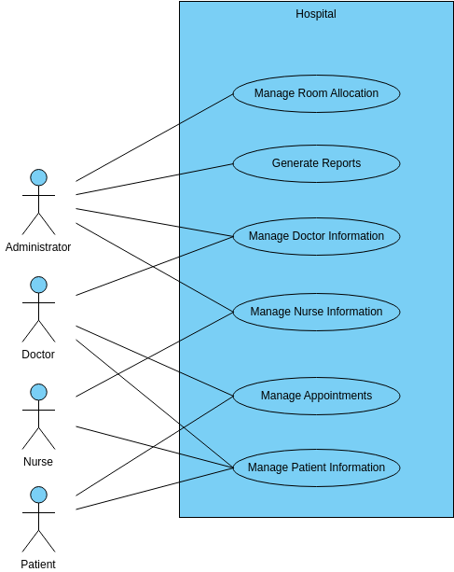
USE CASE DIAGRAM

Slide 18
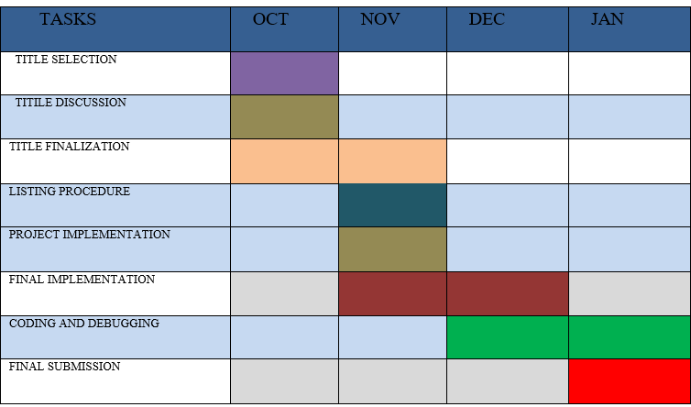
TIMELINE FOR EXECUTION OF PROJECT(GANTT CHART)

Slide 19
OUTCOMES
Through the Hospital Finder app on their smartphone, patients can view their personal health information.Apps can inspire users to take up healthier behaviors and make it easier for patients to find medical providers. How to maintain user engagement is a special problem for mobile apps, though.
Health applications offer the ability to reduce costs, increase patient engagement and empowerment, and provide transparency into treatment outcomes.
Due to digital transformation, the healthcare industry is changing swiftly. This includes treatment management, remote and continuous patient monitoring, early disease

Slide 20
RESULTS AND DISCUSSIONS
Hospital Finder is a comprehensive solution designed to assist individuals during medical emergencies by providing a user-friendly platform to locate nearby hospitals based on specific criteria. The application's interface enables users to input their medical needs, such as the type of treatment required or the specialization of doctors needed.
It then generates a list of nearby hospitals that meet these criteria. Additionally, the application provides real-time information on medicine and blood availability in each listed hospital.
The Hospital Finder addresses a critical issue faced by common people during medical emergencies – the difficulty in deciding which hospital to visit for necessary treatment.

Slide 21
CONCLUSION
The hospital finder app has gained a lot of attention in the past 10 years and is a global phenomenon. In order to assist people achieve their health objectives, mobile technologies—such as smartphones, software programs, and gadgets—are combined in the rapidly developing field of mHealth. Global health service delivery could change if mobile and wireless technologies are adopted in the healthcare industry. The trend of incorporating mobile health solutions into institutional health systems, the quick development of mobile networks and applications, and increased funding, regulation, and evidence have all contributed to this change.
Technology advancements have greatly expanded the potential of mobile health. Smartphones and tablets are transforming the way we utilize mobile devices for health management with features like a high-resolution camera, GPS, and embedded sensors that offer greater capabilities than a laptop or desktop.

Slide 22
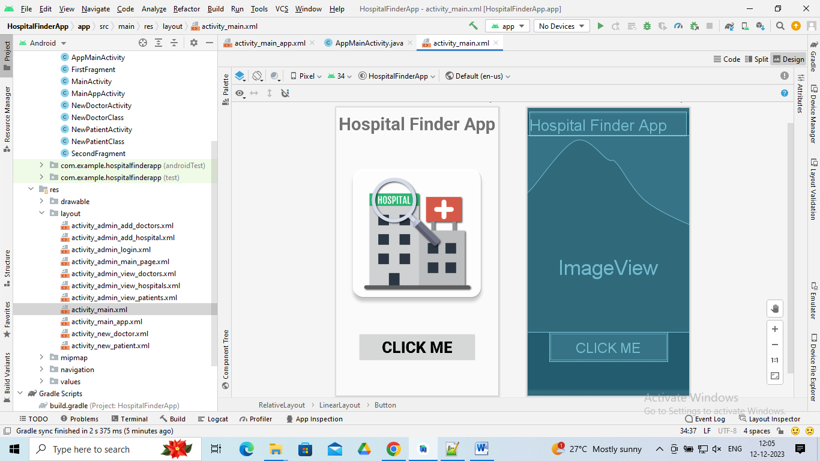
Home Page

Slide 23
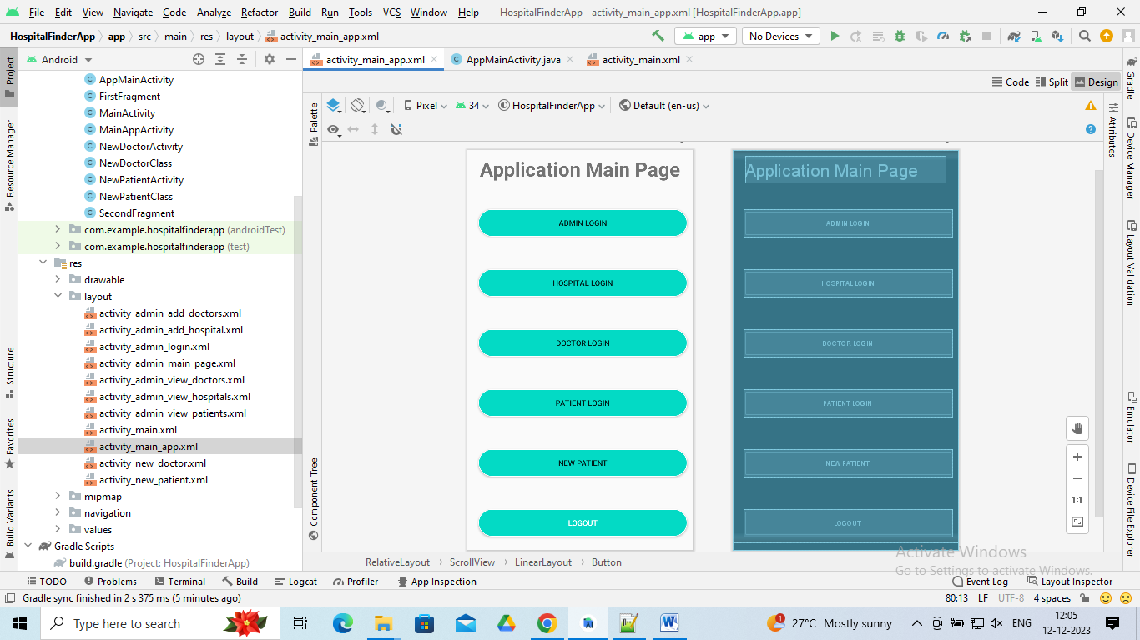
App MainPage

Slide 24
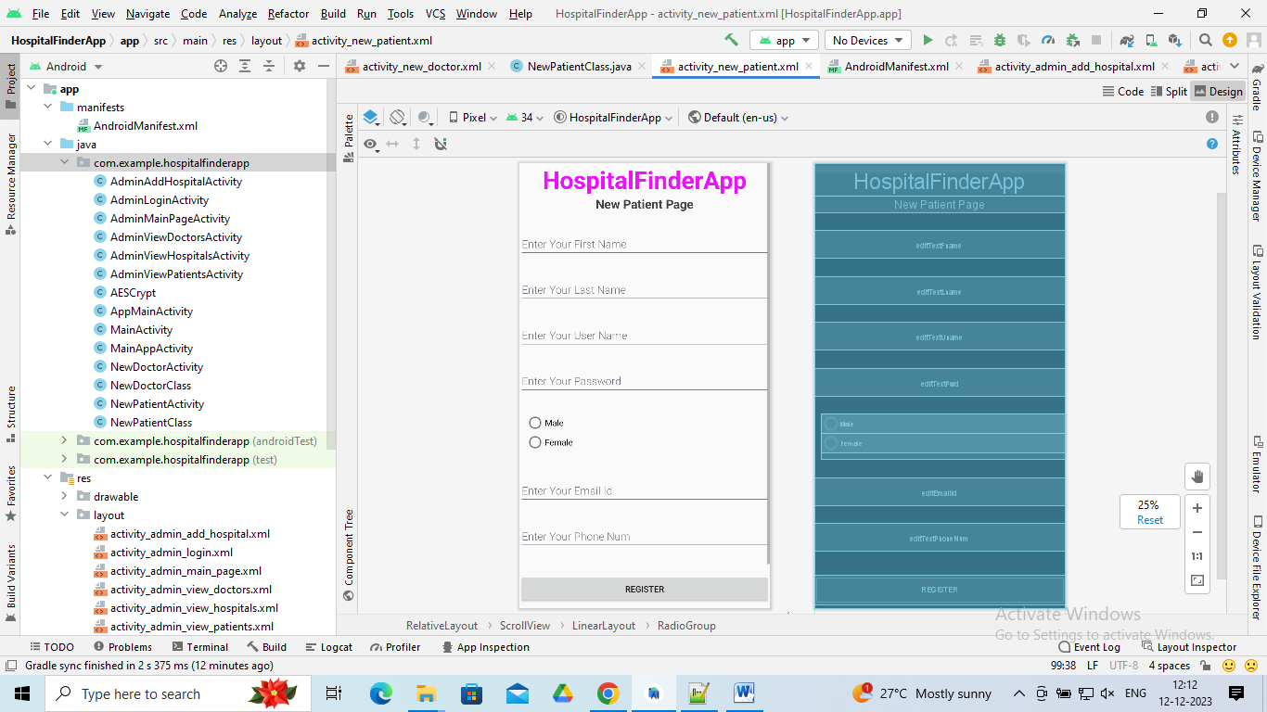
NewPatientPage

Slide 25
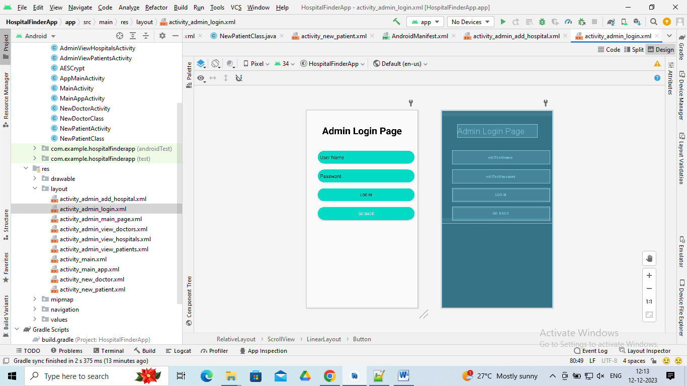
Admin Login Page

Slide 26
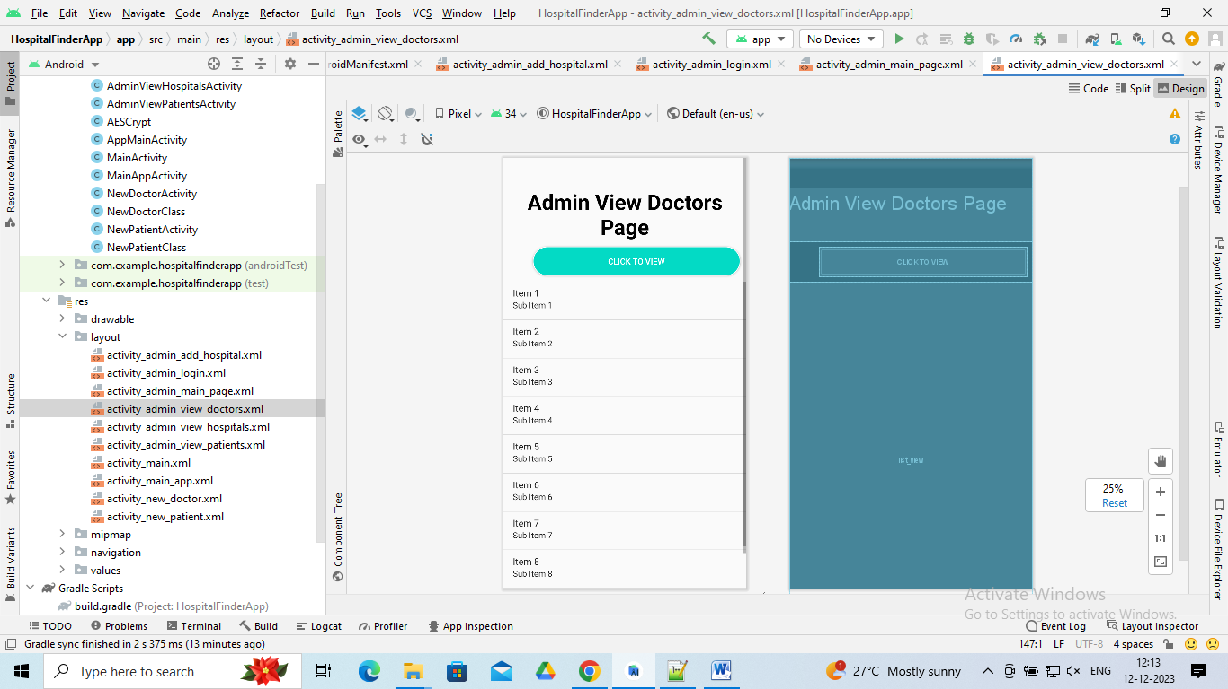
Admin View DoctorsPage

Slide 27
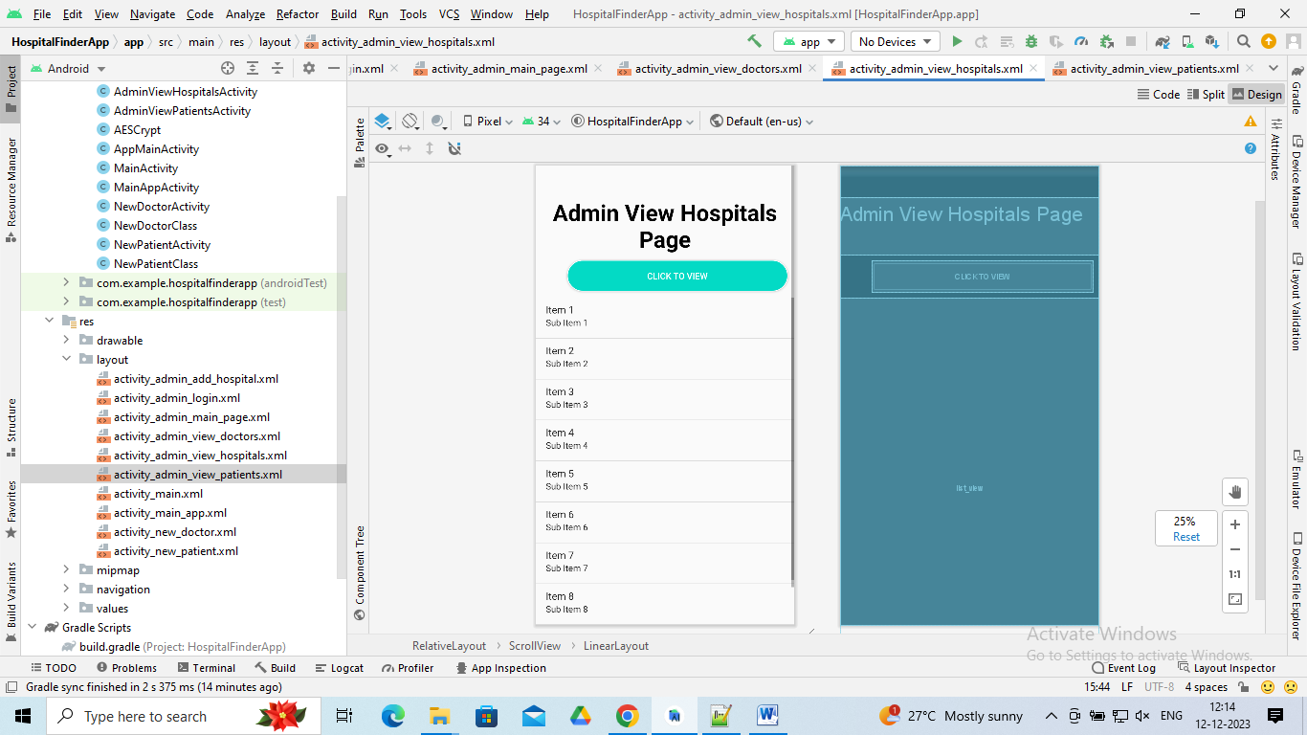
Admin View Hospitals Page

Slide 28
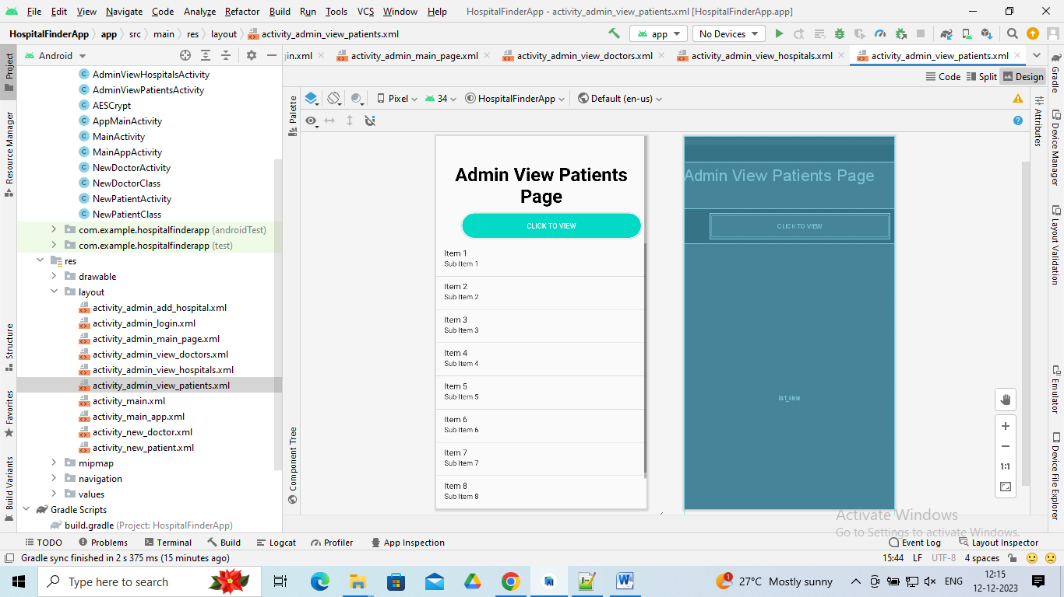
AdminViewPatientsPage

Slide 29
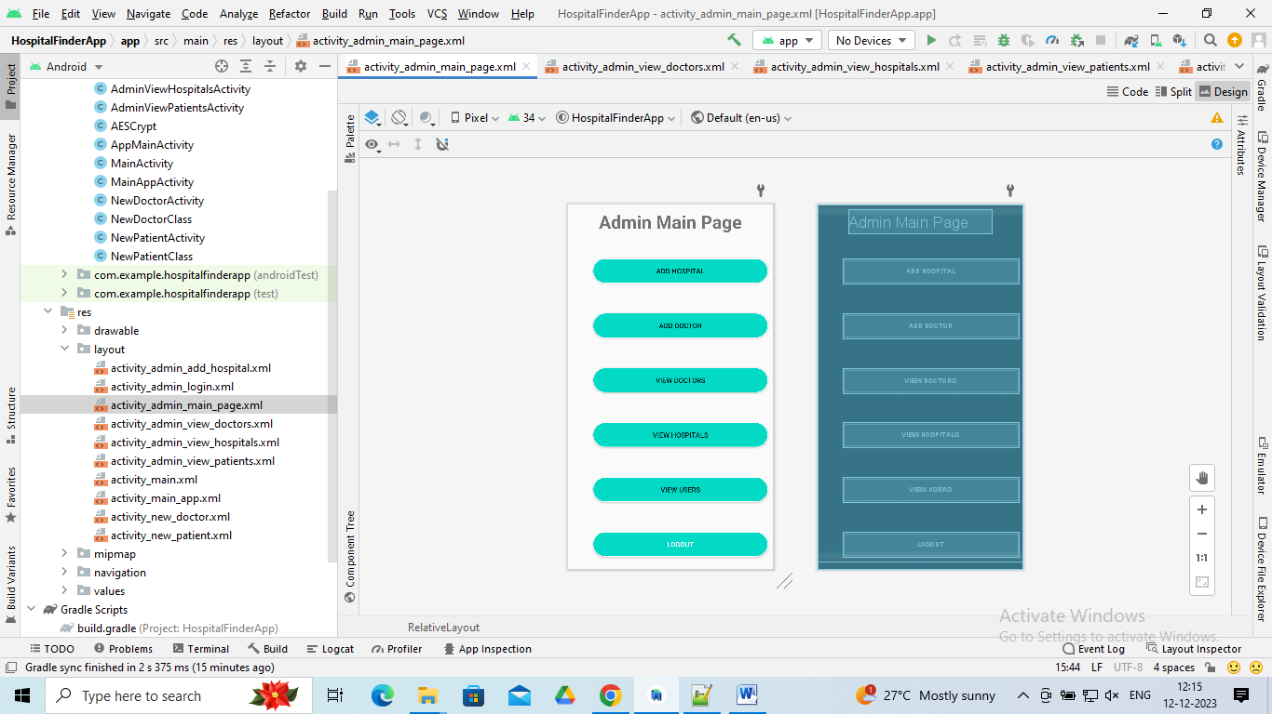
Admin Main Page

Slide 30
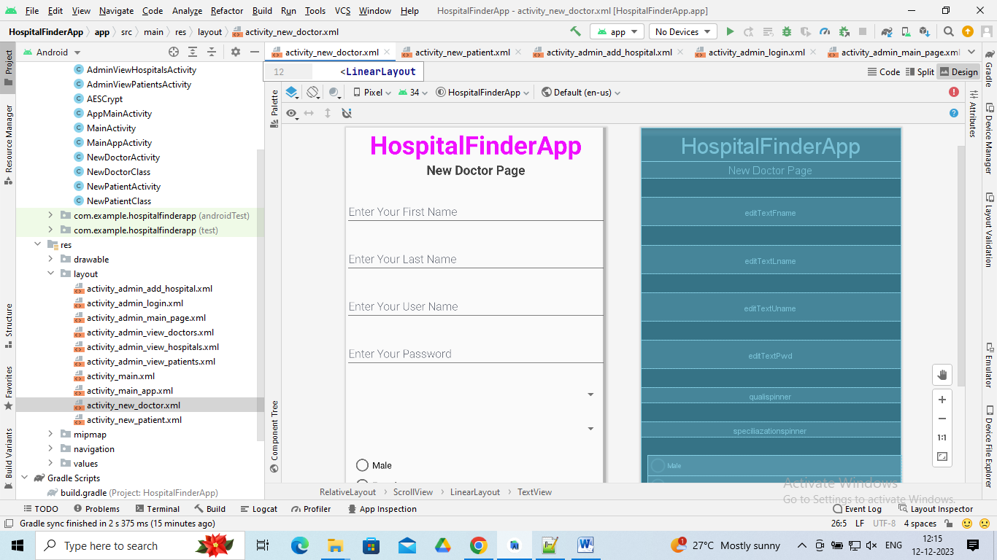
New Doctor Page

Slide 31
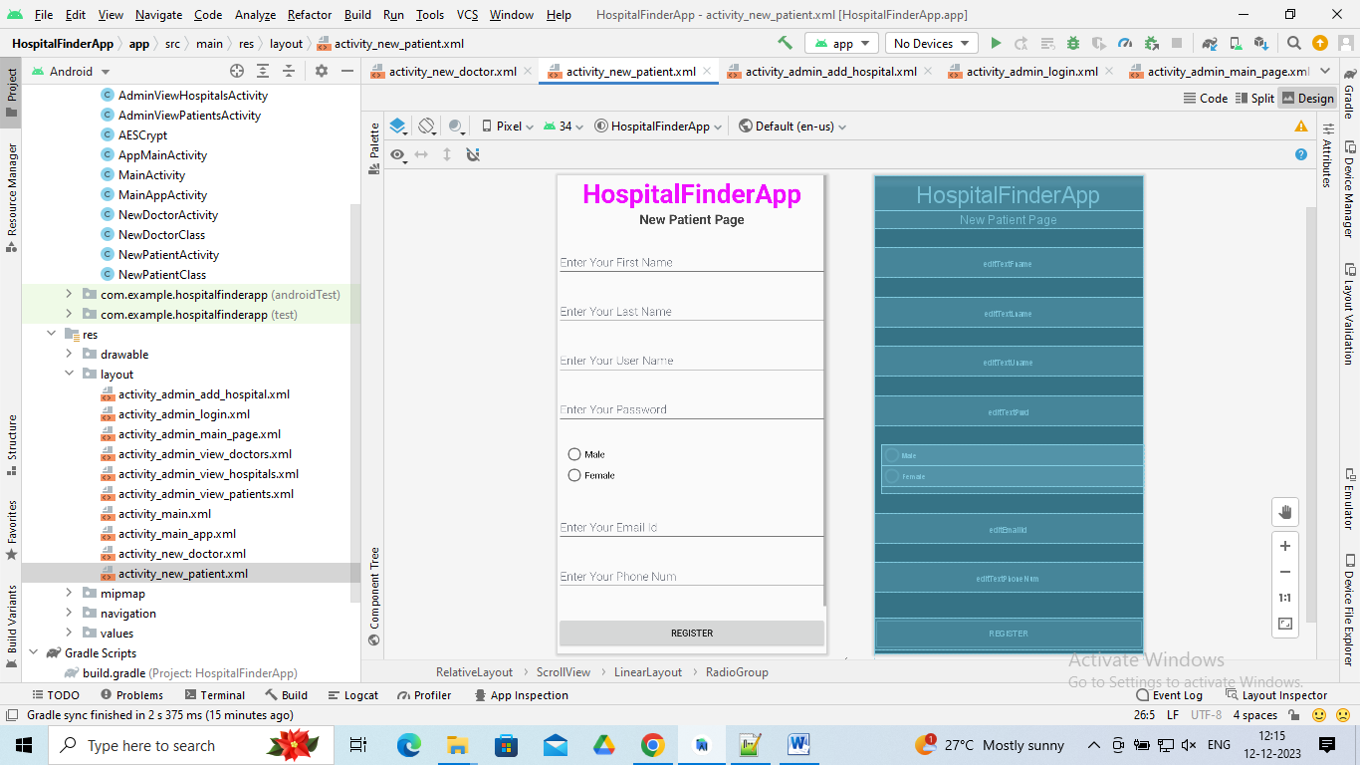
New PatientPage

Slide 32
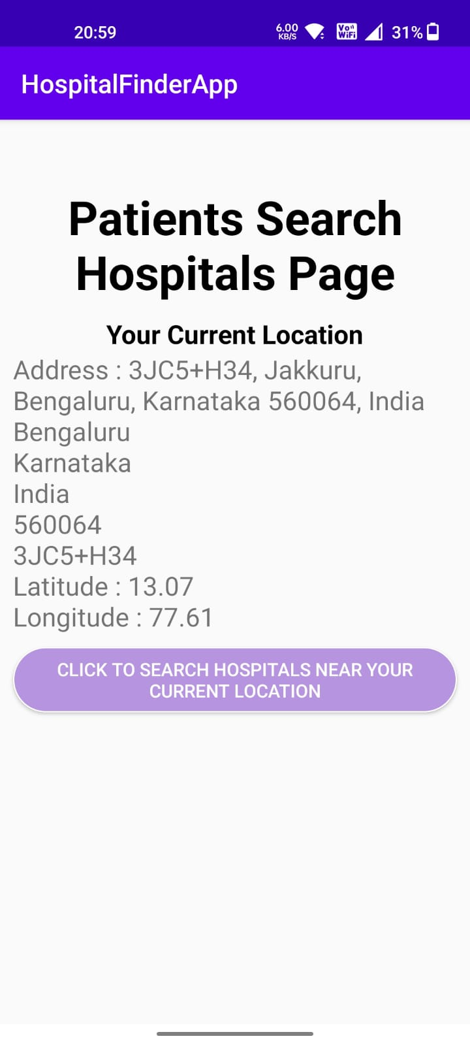
HOSPITAL SEARCH PAGE

Slide 33
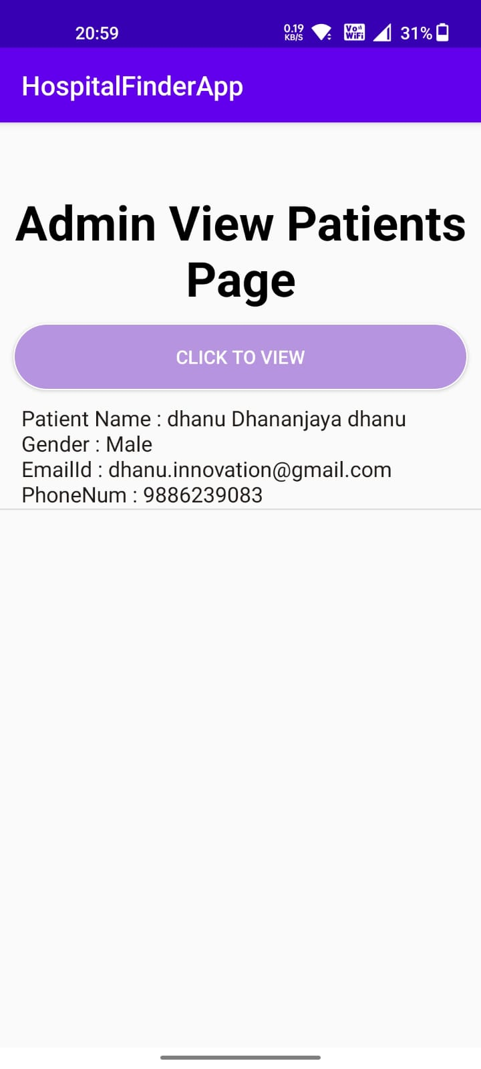
VEIW PATIENTS PAGE

Slide 34
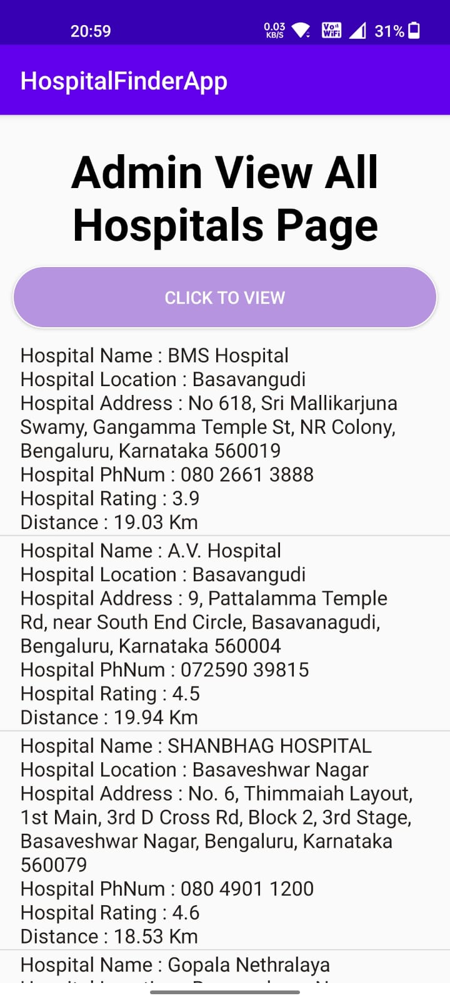
ADMIN VIEW ALL HOSPITALS PAGE

Slide 35
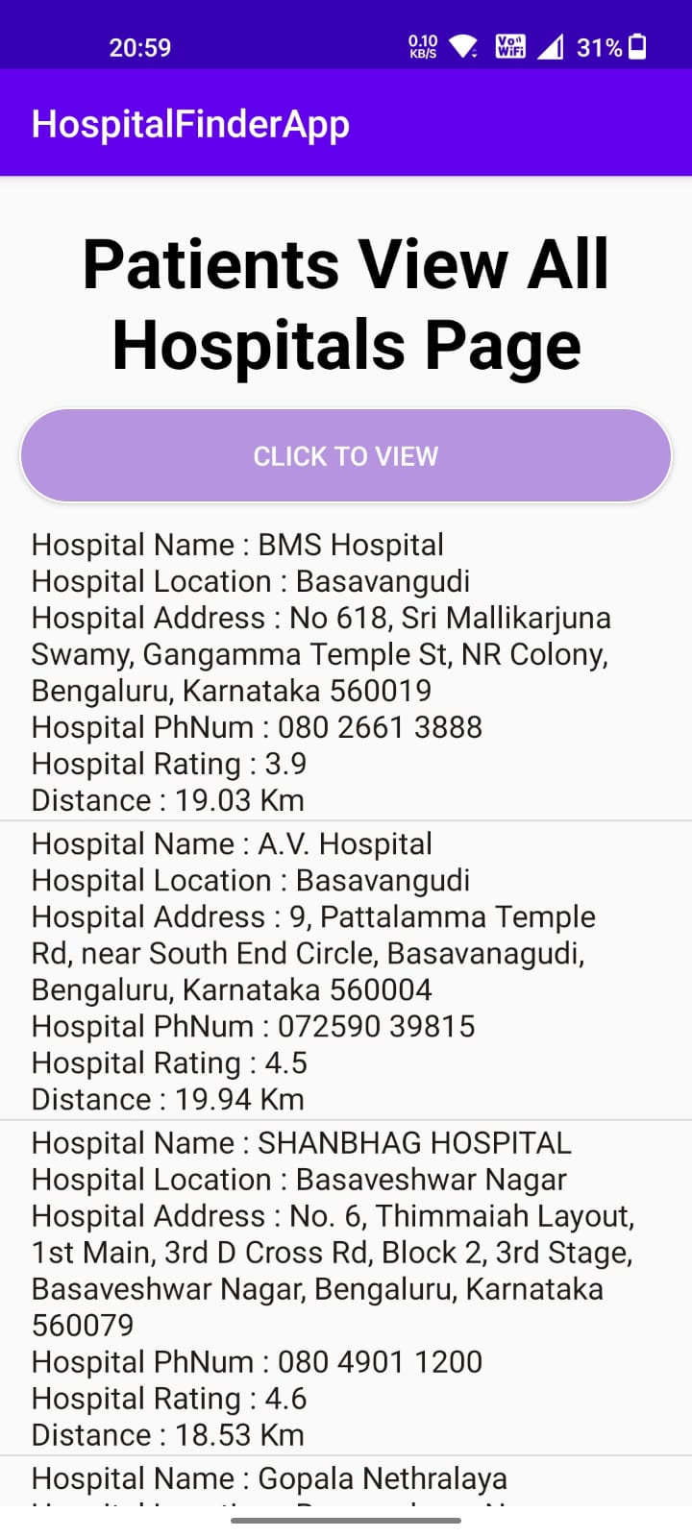
HOSPITAL LISTS

Slide 36
CODE :
MainActivity.xml
<?xml version="1.0" encoding="utf-8"?> <RelativeLayout xmlns:android="http://schemas.android.com/apk/res/android" xmlns:app="http://schemas.android.com/apk/res-auto" xmlns:tools="http://schemas.android.com/tools" android:layout_width="match_parent" android:layout_height="match_parent" tools:context=".MainActivity"> <LinearLayout android:layout_width="match_parent" android:layout_height="match_parent" android:orientation="vertical"> <TextView android:id="@+id/textView" android:layout_width="wrap_content" android:layout_height="wrap_content" android:layout_marginTop="10dp" android:textStyle="bold" android:textSize="45dp" android:layout_centerHorizontal="true" android:layout_gravity="center_horizontal" android:text="Hospital Finder App" />

Slide 37
<ImageView android:id="@+id/imageView" android:layout_width="wrap_content" android:layout_height="500dp" app:srcCompat="@drawable/hospitalfinder" tools:layout_editor_absoluteX="0dp" tools:layout_editor_absoluteY="0dp" /> <Button android:id="@+id/button" android:layout_width="300dp" android:layout_height="75dp" android:gravity="center" android:layout_gravity="center_vertical|center_horizontal" android:textAlignment="center" android:textColor="@color/black" android:textSize="40sp" android:textStyle="bold" android:text="Click Me" /> </LinearLayout> </RelativeLayout>

Slide 38
MainActivity.java
package com.example.hospitalfinderapp; import android.content.Intent; import android.support.v7.app.AppCompatActivity; import android.os.Bundle; import android.view.View; import android.widget.Button; public class MainActivity extends AppCompatActivity { private Button btn; @Override protected void onCreate(Bundle savedInstanceState) { super.onCreate(savedInstanceState); setContentView(R.layout.activity_main); btn = (Buon) findViewById(R.id.button); btn.setOnClickListener(new View.OnClickListener() { @Override public void onClick(View v) { Intent intent = new Intent(getApplicationContext(),MainAppActivity.class); startActivity(intent); } }); } }

Slide 39
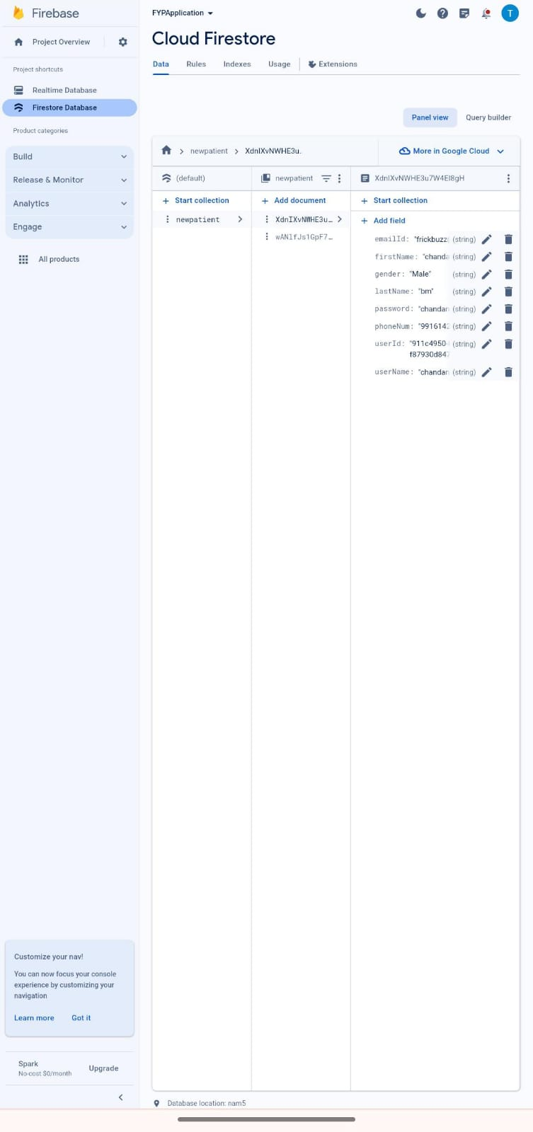
REAL-TIME DATABASE

Slide 40
REFERENCES
User-centric application with a Global Positioning System for regular and emergency medical car
P. Sreelatha; Anush. S; Tamilselvan. A; Vijay. M
2023 Third International Conference on Advances in Electrical, Computing, Communication and Sustainable Technologies (ICAECT)Shrutika Tayade; Rutuja Burde; Sayali Patil; Gauri Mungase; Jayashree B. Kulkarrni 2018 Fourth International Conference on Computing Communication Control and Automation (ICCUBEA) Year: 2018 | Conference Paper |
A Mobile App to Facilitate Socially Distanced Hospital Communication During 2 COVID-19: Implementation Experience. Cite Anyanwu EC, Ward RP, Shah A, Arora V, Umscheid
A Smartphone-Based Model of Care to Support Patients With Cardiac Disease 4 Transitioning From Hospital to the Community (TeleClinical Care): Pilot
Randomized Controlled Trial

Slide 41
THANK YOU!

